Slide 1
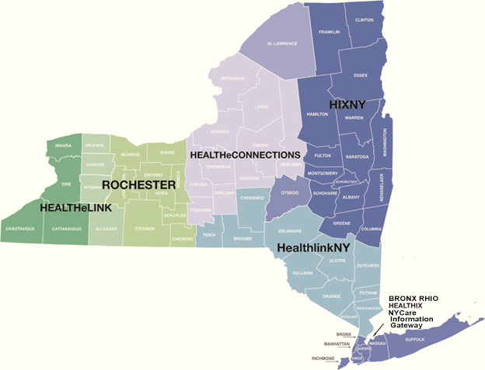
State Health Information Network – New York (SHIN-NY)

